Slide 1
Step 1
Registering new idea
Creating the Initiative S0

Slide 2
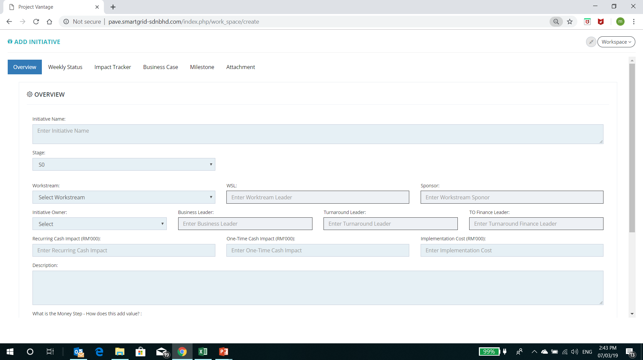
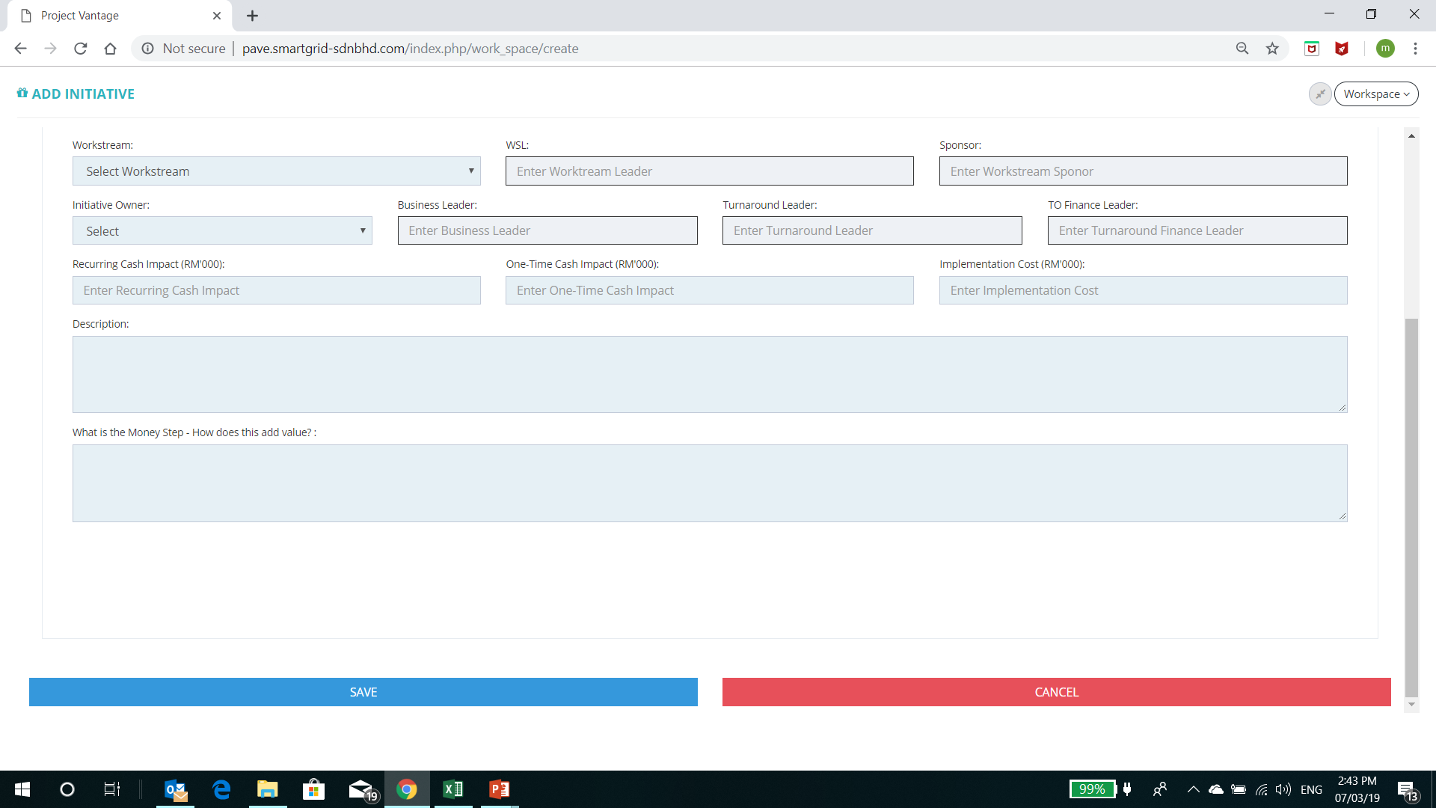
This tab is inactive during creating the S0 stage. After Save only timeline and Weekly status is available
Mandatory field for user for Save. Error Msg will be appeared if this field are empty
Workstream, Initiative Owner, Description and money field step is not required/mandatory for SAVE
To add additional box
One-Time Implementation cost
Recurring Implementation cost
After Save, the initiative ticket is maintained/stayed and not revert back to list menu

Slide 3
Step 2
IO and Workstream nomination
Identified

Slide 4
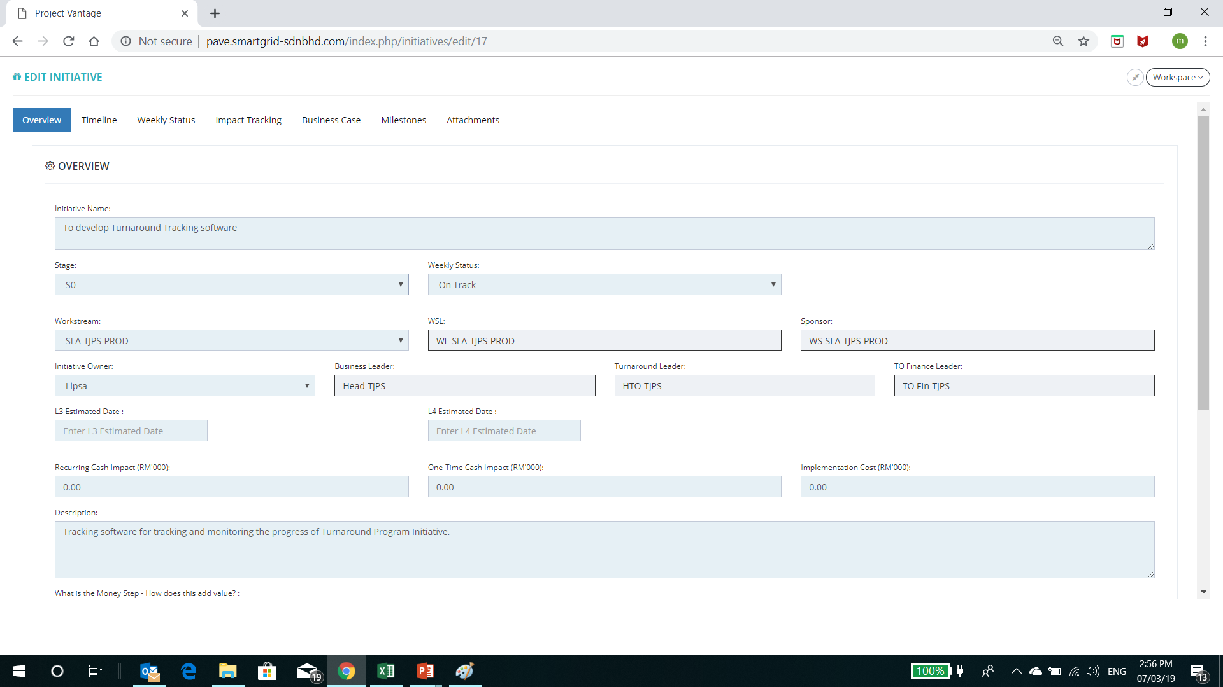
To put registered initiative number #XX
This tab is inactive during S0 stage
Selection for Stage
S0
Submitted to S1
Mandatory field for user for Submitted to S1. Error Msg will be appeared if this field are empty

Slide 5
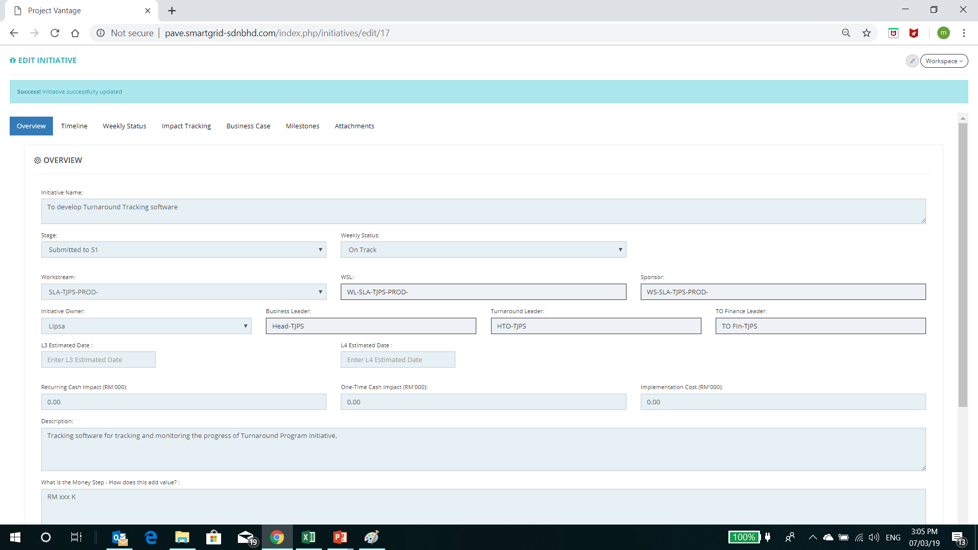
This tab is inactive during Submitted to S1
Selection for Stage
S0
Submitted to S1
All field will be locked during submitted to S1 except this 2 field
Reject. After approver click this button. Popup remarks box will appear (mandatory to fill up). And the this initiative automatically to S0
Approve. After approver click this button. Popup remarks box will appear (Not mandatory to fill up). And the this initiative automatically to S1
Approve and Reject Button during Submitted to S1. Only Applicable for Approver Right Only
Approve
Reject

Slide 6
Step 3
Preparing the business case
Validated

Slide 7
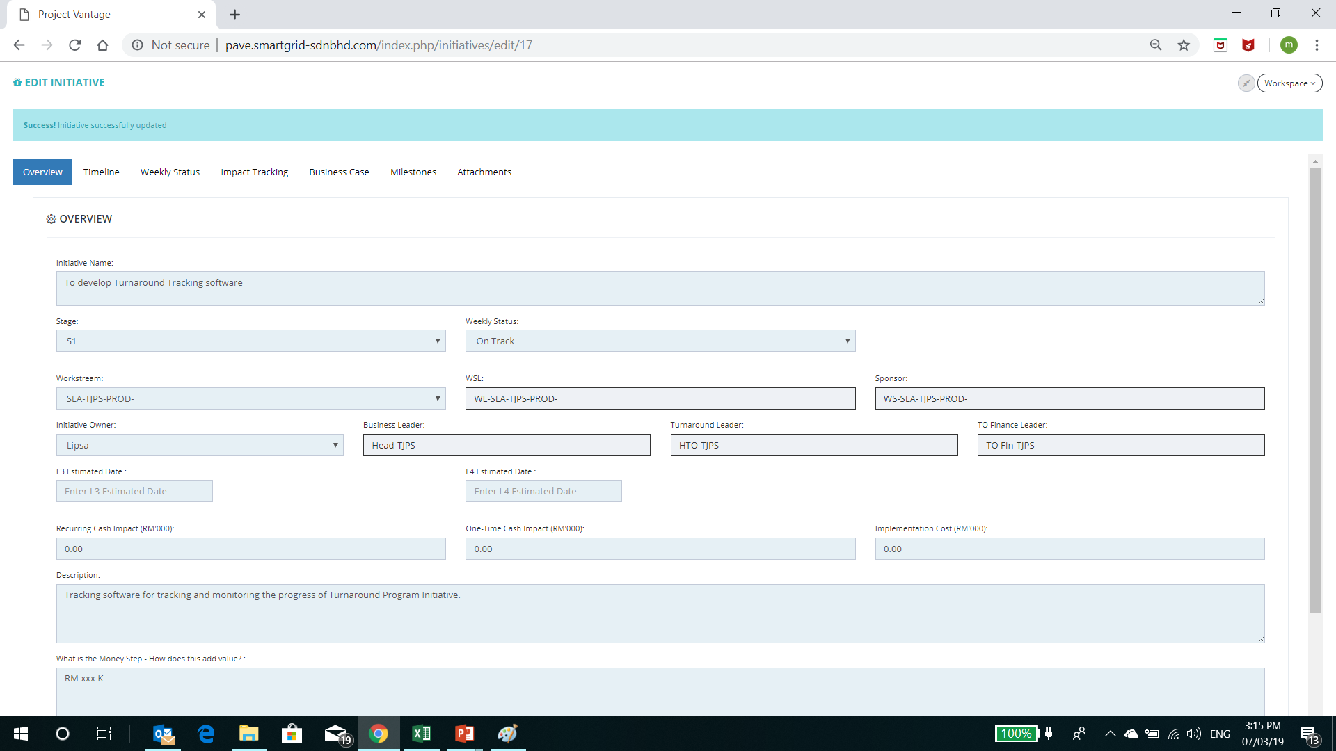
This tab is inactive during S1
Selection for Stage
S1
Submitted to S2
Mandatory field for user for Submitted to S2. Error Msg will be appeared if this field are empty

Slide 8
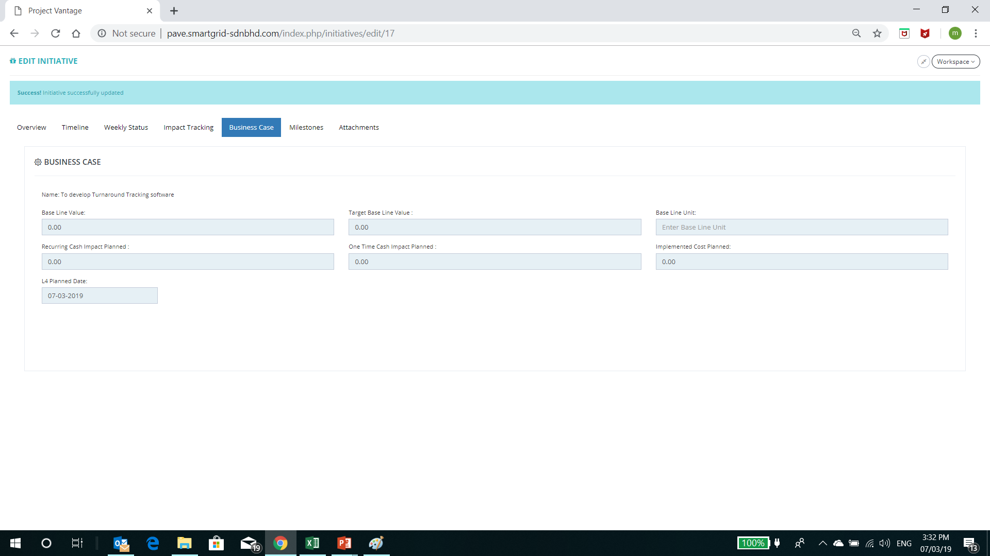
Mandatory field for user for Submitted to S2. Error Msg will be appeared if this field are empty
To be change to S4 planned Date
Data to be taken from calculated info from Impact tracking tab. Please add extra for OT and RR Implementation cost

Slide 9
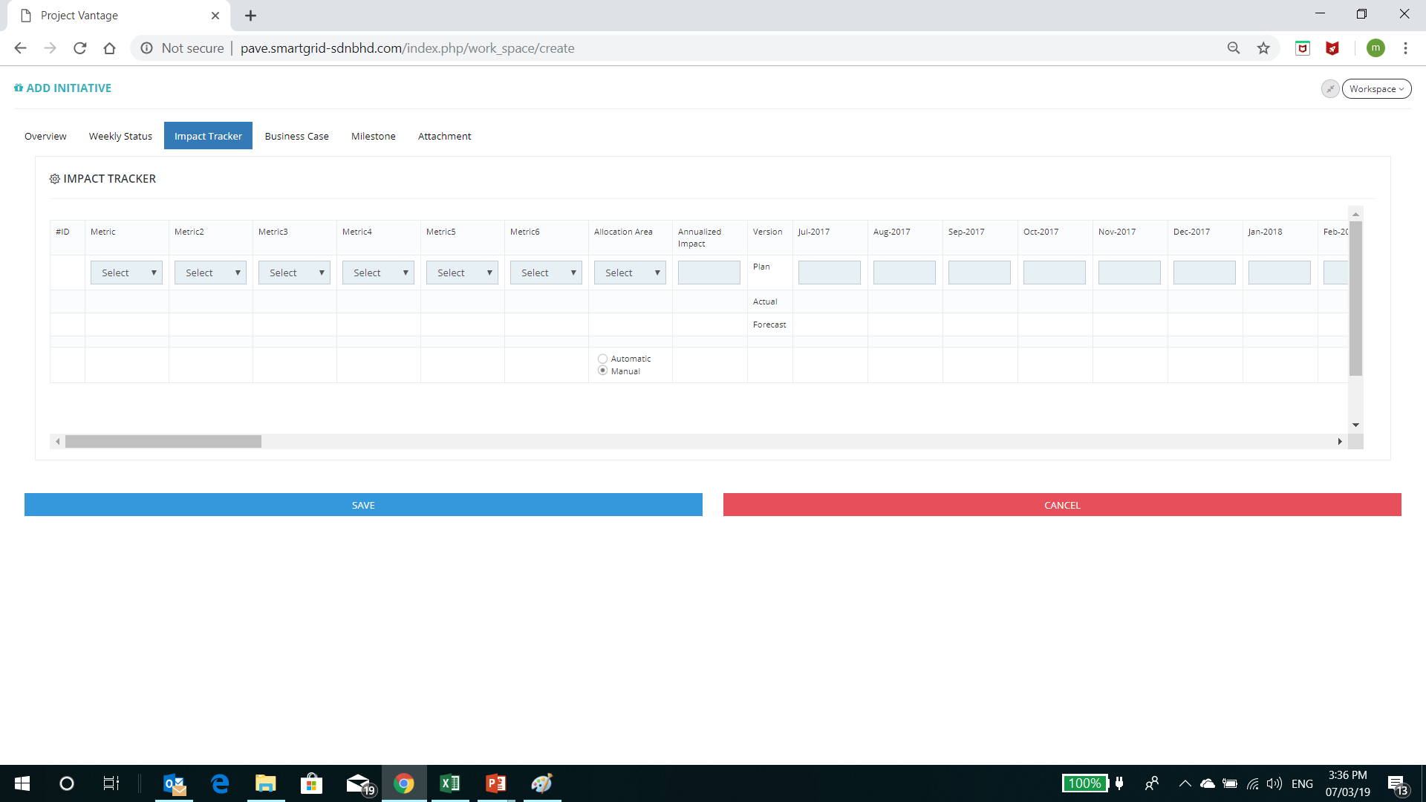
Mandatory field for user for Submitted to S2. Error Msg will be appeared if this field are empty
Mandatory field for user for Submitted to S2 (At least 1 field is filled up). Error Msg will be appeared if this field are empty

Slide 10
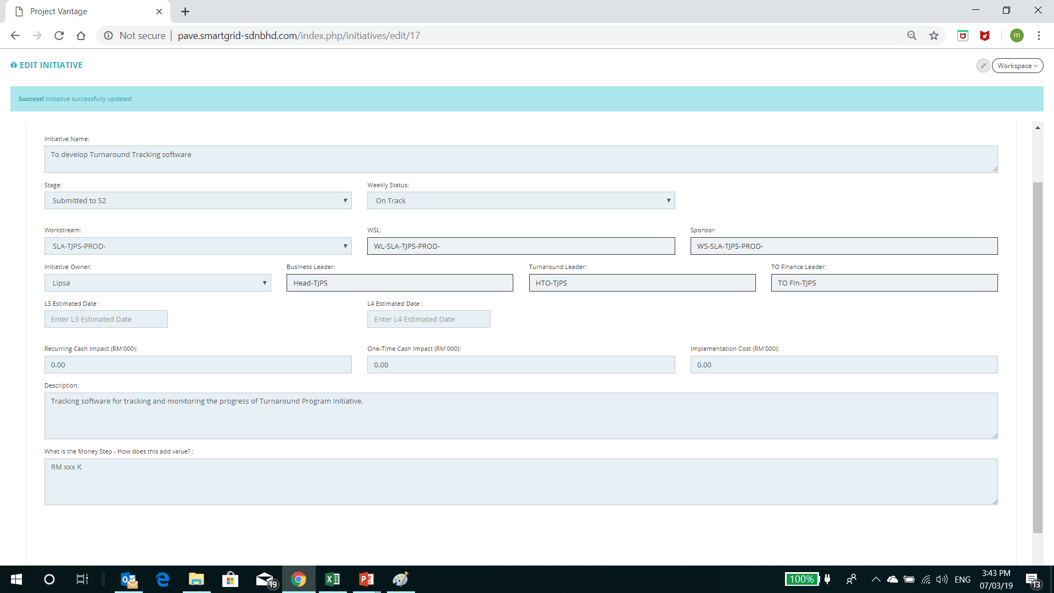
Selection for Stage
S1
Submitted to S2
All field will be locked during submitted to S2 except this 2 field
Reject. After approver click this button. Popup remarks box will appear (mandatory to fill up). And the this initiative automatically to S1
Approve. After approver click this button. Popup remarks box will appear (Not mandatory to fill up). And the this initiative automatically to S2
Approve and Reject Button during Submitted to S2. Only Applicable for Approver Right Only
Approve
Reject

Slide 11
Step 4
Preparing the workplan
Planned

Slide 12
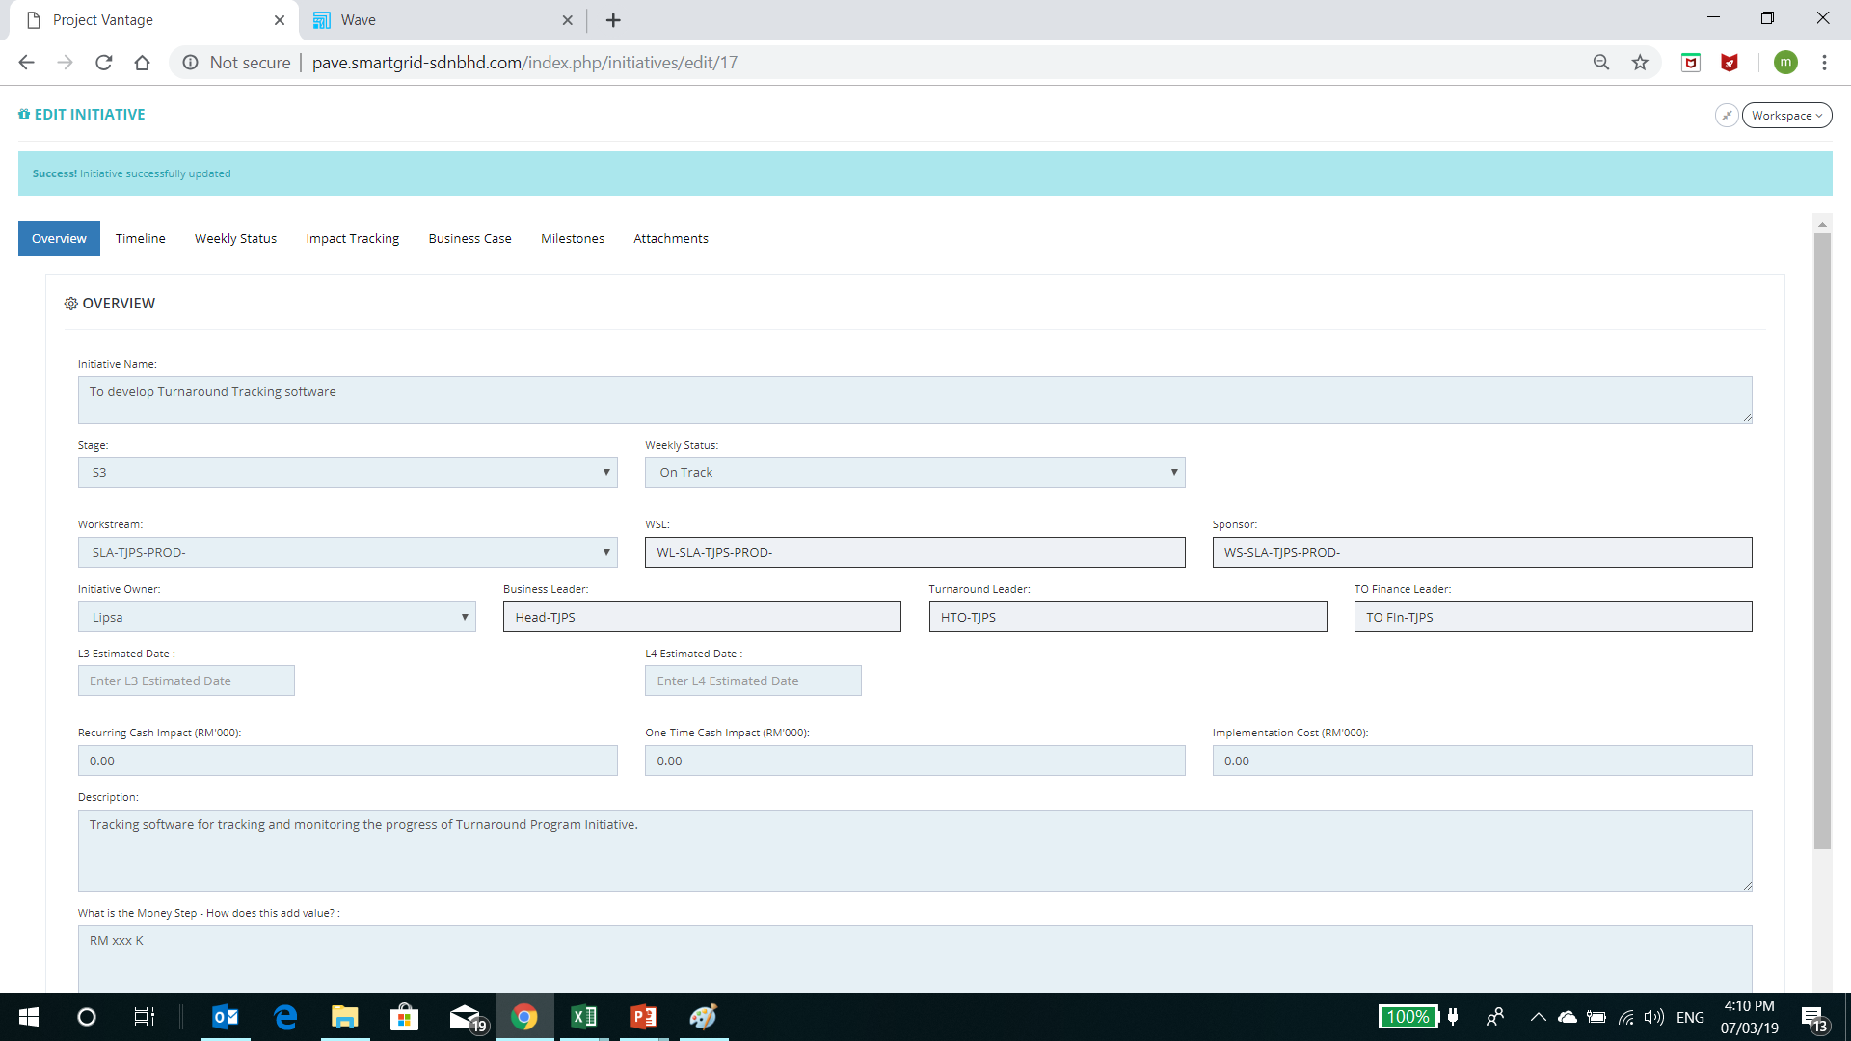
All Tab now active at S3 stage
Selection for Stage
S1
S2
Submitted to S3
S2
Data taken from Business case tab. Change to S4 Estimated Date
Data taken from Impact Tracking tab.

Slide 13
This field will be locked at S2
This field will be activated .Mandatory field for Submitted to S3. Error Msg will be appeared if this field are empty for forecast version.

Slide 14
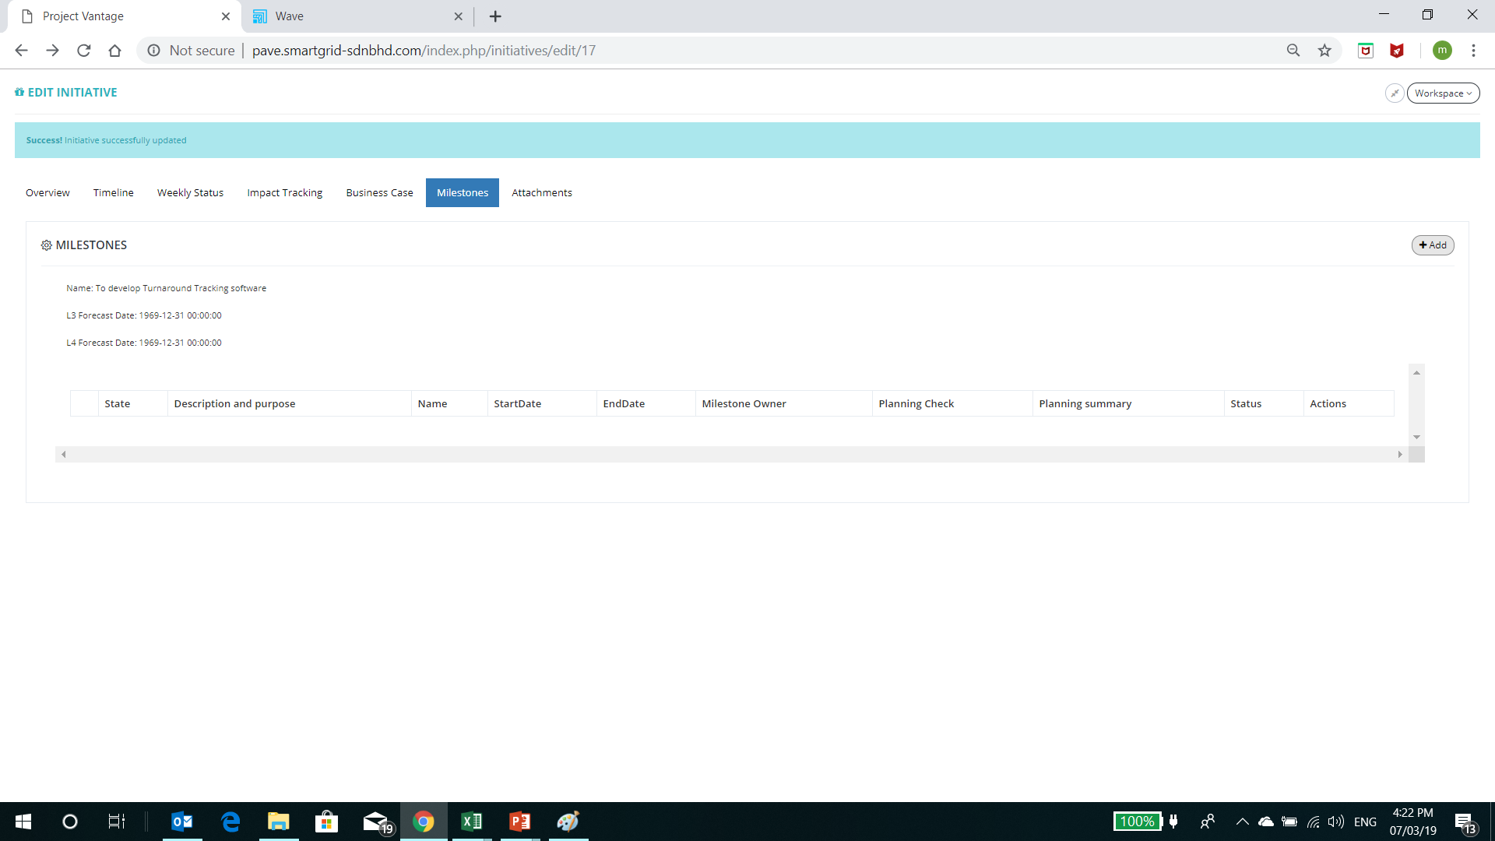
.Mandatory field for user for Submitted to S3. Error Msg will be appearedd. At least 1 milestone to be created.

Slide 15
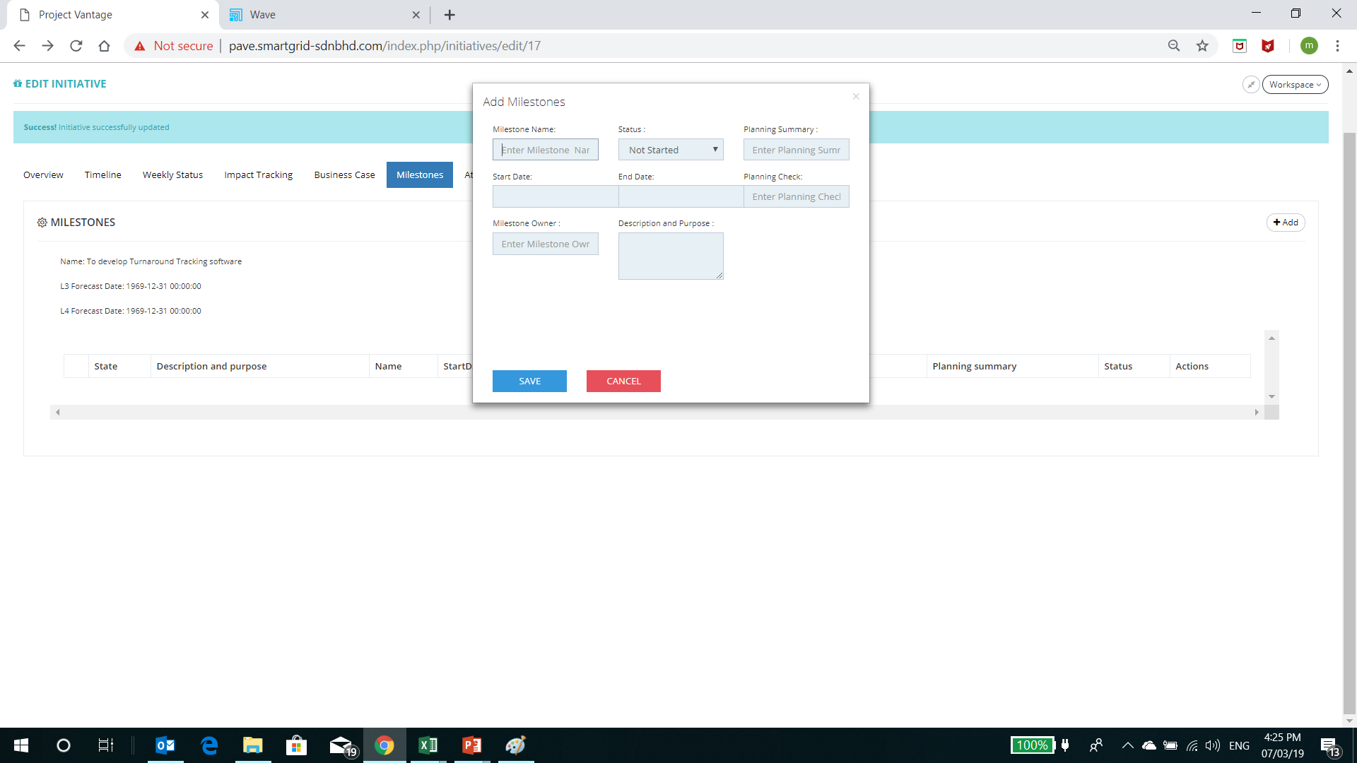
Comment : Bigger box and field
Automatic check by the system
Comment : Calendar assist fill up
Planning Summary
Planning Check
Planning Summary Output | Condition check
 | Status selection | Start Date | End Date
Not Started | Not Started | Current Date < Start Date | Nil
Late to Start | Not Started | Current Date > Start Date | Nil
Late | Started | Nil | Current Date > End Date
In progress | Started | Current Date > Start Date | Current Date < End Date
Cancelled | Cancelled | Nil | Nil
Completed | Completed | Nil | Nil
Planning Check Output | Condition check
Plan OK | Start date before end date and milestone owner filled up
Plan not OK – Start date after end date | Entered start date is later than end date
Plan not OK – Missing Start Date | Start date not entered
Plan not OK – Missing end date | End date not entered
Plan not OK – No milestone Owner | Milestone owner not filled up

Slide 16
Selection for Stage
S1
S2
Submitted to S3
All field will be locked during submitted to S3 except this 2 field
Submitted to S3
Reject. After approver click this button. Popup remarks box will appear (mandatory to fill up). And the this initiative automatically to S2
Approve. After approver click this button. Popup remarks box will appear (Not mandatory to fill up). And the this initiative automatically to S3
Approve and Reject Button during Submitted to S3. Only Applicable for Approver Right Only
Approve
Reject

Slide 17
Step 4
Initiative Implementation
Executed – To be continue

